Slide 1
Module 3: Model Assessment, Optimization, Predictions
Ben Afflerbach
5/11/2020
Dane Morgan
9/6/2022

Slide 2
A Basic Materials Design Workflow
Identify Materials Properties
Train Model of Properties
Predict Properties For New Chemical Compositions
Synthesize and Verify Predictions
Training Details
Generate Training Data
Data Cleaning
Feature Generation and Engineering
Model Assessment
Model Optimization
Predictions
Notes:
Throughout these materials we’ll be calling back to our over-arching example of performing materials design
Now we’ll dive into the second three steps in the training workflow
These encompass things that need to be done to ensure we build the best model possible

Slide 3
So how do we actually “train” a decision tree?
Search through available features to split on
For each feature find the best value to split on
Look at all combinations of features and values and choose the one the optimizes performance (e.g., root mean squared error on data) if the tree stopped there
Repeat for next level of nodes
Root
Leaf
Decision
Decision
Leaf
Leaf
Leaf
Remember: As we work down the tree, we’re progressively splitting the data
Notes:
We’ll be talking about model training and it’s important to first understand what we mean by training.
Using the procedure on the right features and values are assigned to each node
Key thing to remember is we don’t decide what the nodes are, that’s the learning process. We only decide the features to use and some hyperparameters which affect how the learning proceeds

Slide 4
We Could Make Predictions Now
Root
Input Data
How do we decide if this is a good prediction?
How confidence should we be in the model?
We need some way to quantify performance!
Leaf
Decision
Decision
Leaf
Leaf
Leaf
Prediction
Notes:
Once we’ve fit a tree we could start making predictions
But should we trust those predictions? We need some way to assess the model and decide on how much we trust it
Bold large text shows one example prediction pathway

Slide 5
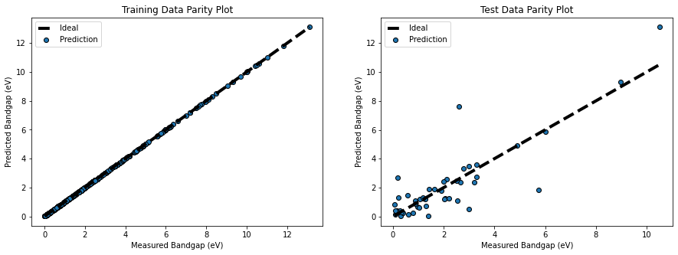
What do predictions look like after training?
Parity Plots
Compare ML predictions to the “known” values from a dataset
Show errors as deviations from the line Y=X
Predicting data the model has trained on:
Often gives errors of ~0 for complex ML models
Doesn’t tell us how the model performs on “new” data it hasn’t seen

Slide 6
What if we had new data the model hasn’t trained on?
Predicting data the model hasn’t trained on:
Usually gives non-zero errors
Gives a much better approximation of “real world” performance
How do we get new data the model hasn’t trained on?

Slide 7
Workflow Step 4: Model Assessment (Key Terms)
Training Data:
Data that the model is fit to
It is expected that the model would predict this data very well, because it’s explicitly what it was trained on
Testing Data:
Data that is withheld until a “final” model has been fit. Then it is predicted
Known values are compared with predictions to assess error
Validation Data:
Similar to testing data (and sometimes this term is used interchangeably which can be confusing).
Data that is temporarily withheld from the Training Data during a cross-validation procedure.
Used to optimize a model before the “final” model has been determined
https://scikit-learn.org/stable/modules/cross_validation.html
Notes:
Before talking in more detail on assessment there’s three terms that we need to have clear in our minds

Slide 8

Workflow Step 4: Model Assessment
Train/Test Splits:
Separate which data a model is trained on, and which is compared against to assess errors
K-Fold Cross Validation:
Make “K” splits in the data.
Train a series of models using each fold as testing data once while training on the rest.
Assess error on average across all splits
https://scikit-learn.org/stable/modules/cross_validation.html
Notes:
To get some sort of estimate of model performance we need to make predictions on some data where we know what the correct answer in
So instead of training on all available data we’ll make splits in the data and only train on parts of it
Two methods are shown here, a single train/test split, and a more involved k-fold cross validation scheme
Generally the single train/test is used for final model evaluation and cross validation is used for model optimization which we’ll talk about next

Slide 9





Workflow Step 4: Visualizing Test Data Errors
Parity plots show qualitative trends in predictions
Notes:
Parity plots are one of the easiest ways to qualitatively see how regression models are performing
A few typical kinds of errors are shown.
Quantitative error metrics are shown on the right (more on next slide)

Slide 10
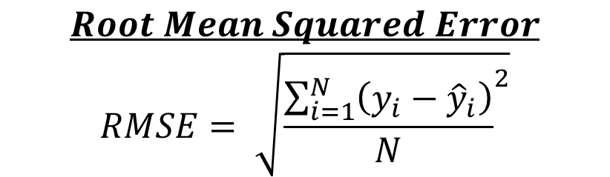
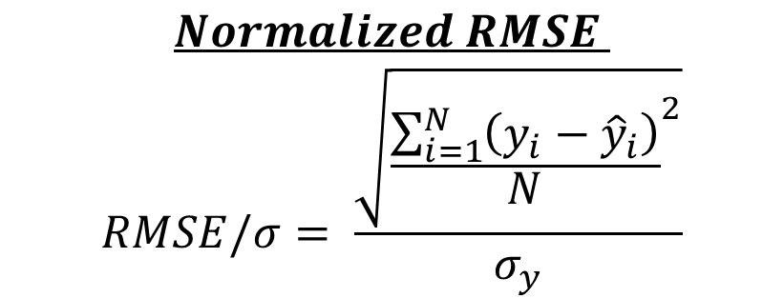
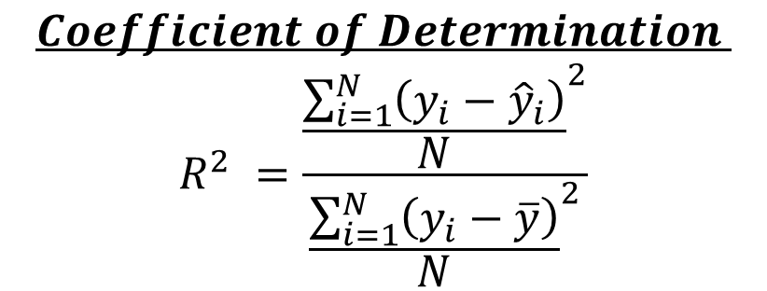
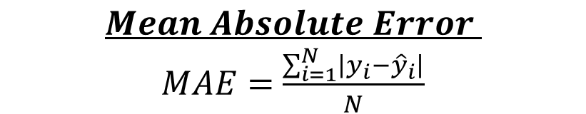
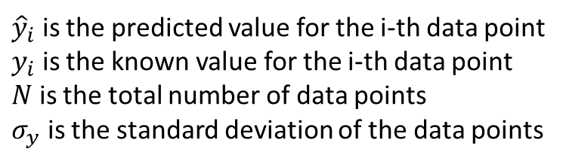
Workflow Step 4: Quantifying Test Data Errors

Slide 11
Workflow Step 5: Model Optimization
Model Parameters
Model Hyperparameters
Parameters are aspects of the model that get set during fitting! This is what the machine ”learns”.
Humans don’t decide these directly!
For example in polynomial regression (fitting Y(x)=a0+a1*x+a2*x^2+ …an*x^n) these are the ai values.
These are the aspects of the model humans change to affect model performance!
They affect how the model learns, and therefore how the parameters are determined during fitting
For example in polynomial regression (fitting Y(x)= a0+a1*x+a2*x^2+ …an*x^n) this would be n.
Why two parameter groups? Model parameters can be fit with high numerical efficiency. Hyperparameters cannot so are generally set by user or non-standard optimizations.
Notes:
After we’ve built an initial model and understood it’s performance we want to know if we can change and improve it at all.
To do this we need to change the hyperparameters of the model
Hyperparameters are values that affect how the learning process takes place!
Specific example would be limiting the maximum tree depth so that a simpler model is made

Slide 12
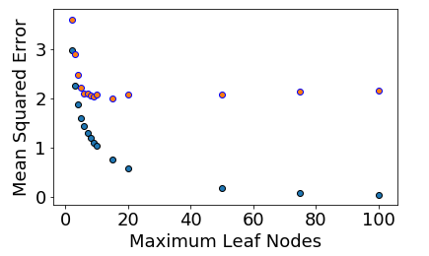
Example: Optimizing Band Gap Predictions
Strategy:
Identify a grid of hyperparameters of interest
Use a cross validation strategy in combination with a desired error metric to quantify performance
Test data
Training data
(Random forest hyperparameter)
Notes:
Here’s an example plot we might make when optimizing for our band gap example
This type of plot (Error metrics vs hyperparameter) can be used to visual how performance changed
In this case we did a very simple grid search over one hyperparameter. Generally though you’d want to check a whole bunch of combinations of different hyperparameters

Slide 13
Workflow Step 6: Model Predictions
Identify materials of interest to predict:
Maximize, Minimize, or predict a target range for a property
Is there a specific target material, or composition space of materials, that is of interest?
For our Band Gap example:
We could want a bandgap around 1.4 eV to maximize efficiency of a single-junction solar cell
We also might only be interested in earth-abundant elements, so we would limit our search
Important: Although this step comes at the end. Thinking about how you want to use a model, should be one of the first things in any modeling process!
Notes:
Finally we get to make new predictions!
The previous assessment tests ideally have given us a sense of the error in the model so now we have a better understanding of how much we can trust the predictions

Slide 14
Summary
Model Assessment is the way in which we can decide how much to trust a model
We can also change hyperparameters of a model to affect its performance.
Once a final model is chosen, we can make predictions for new materials!
Generate Training Data
Data Cleaning
Feature Generation and Engineering
Model Assessment
Model Optimization
Predictions
Notes:
This is a basic overview of how we get to the stage of making predictions

